Slide 1

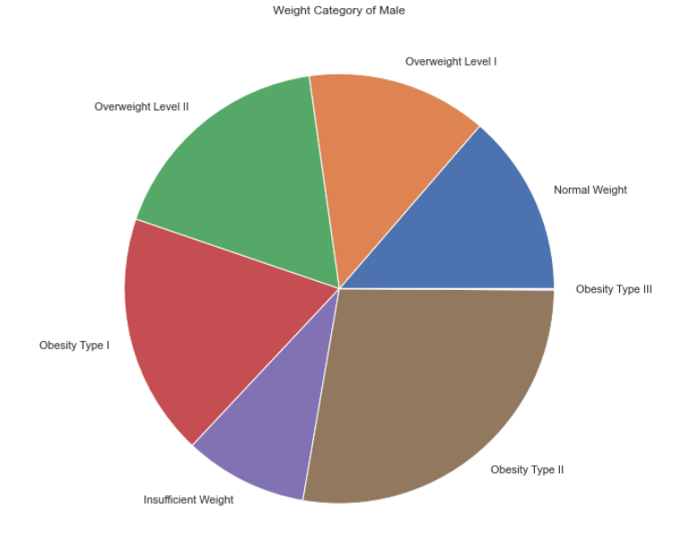
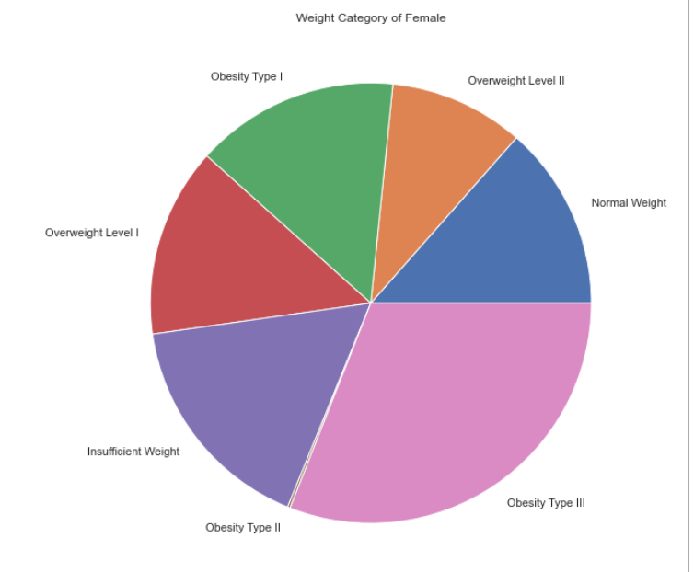
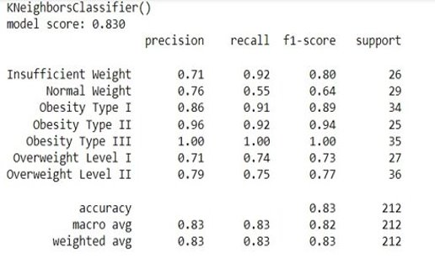
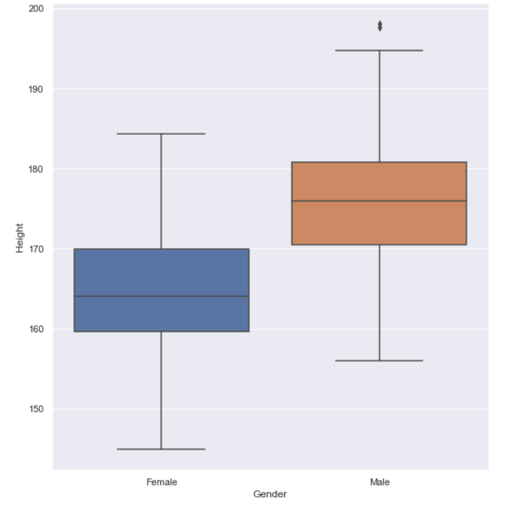
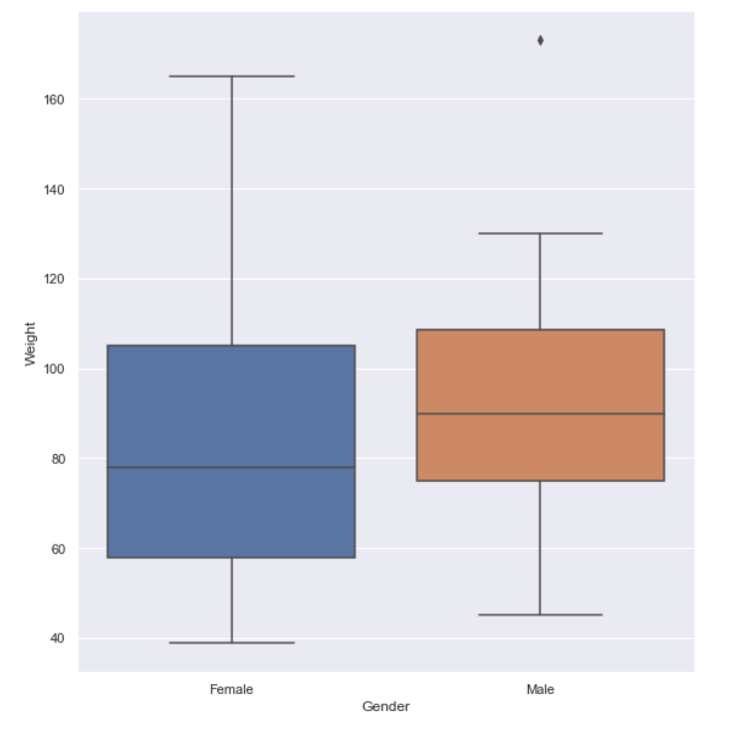
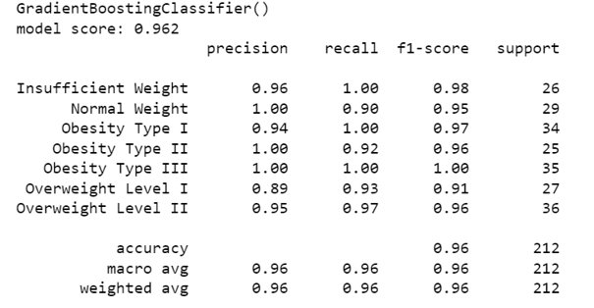
Estimation Of Obesity Rates In Mexico,Peru & Columbia Based On Individuals Dietary,Exercise &Daily Habits
Samyuktha Donthiboina
Mentor: Dr. Christelle Scharff
Pace University, Seidenberg School of CSIS
GitHub: https://github.com/Samyuktha9928/Capstone_Project
Abstract
Methodology
Experiments
Conclusion & Future Work
The article discusses how machine learning models are being used to understand and predict obesity. Two studies are reviewed, one using five different machine learning algorithms to predict obesity based on demographic, lifestyle, and health factors, and another using a neural network model to predict obesity based on health and physical activity factors. Both studies found the models to be effective in predicting obesity, with the neural network model achieving an accuracy of 86.5% and an AUC of 0.93. The authors of both studies concluded that machine learning models are a useful tool in predicting obesity and identifying key predictors.
Research Question
Can you predict the possibility of occurrence of obesity in the early stages using previously recorded data?​
Is smoking really a factor that affects obesity?
Related Work
Some Researchers have used individual’s daily habits to estimate obesity levels and develop prediction models using machine learning and statistical techniques. Some notable works include an Android application by A. Ş. Sevim and E. İnal, a comparison of machine learning techniques by M. A. Saleh, H. M. Kamal and S. A. Rahman, obesity prediction based on food habits and physical activity by A. Almasri and F. Mismar, and a comparative analysis of machine learning algorithms using personal data by S. Agrawal and S. Pandey.
Dataset
The dataset describes a study conducted in Mexico, Peru, and Columbia to estimate obesity rates based on dietary, exercise, and daily habits of individuals. Obesity is measured using a target variable with 7 classes. There are 2111 individuals & 17 attributes, including gender, transportation used, and technology usage, that are likely to determine obesity. The data set includes both numerical and categorical data, which are pre-processed using imputation, point scaling, and encoding
The article outlines a machine learning approach for predicting obesity. The approach involves collecting data on various factors contributing to obesity, pre-processing the data, selecting relevant features, and training multiple machine learning models, including K Nearest Neighbour, Decision Tree, Random Forest, Ada boost, Stochastic Gradient Descent, and Support Vector Machine. The models are then evaluated based on metrics such as accuracy and optimized to improve their performance. Finally, the selected model is used to predict obesity in new data. Further improvements can be made by incorporating additional data sources and using ensemble techniques.
Machine learning classification techniques have been effective in predicting obesity by using various features like demographic, lifestyle, and clinical factors. Future research can focus on developing sophisticated algorithms, integrating wearable technology and mobile health apps for real-time data collection, and identifying new risk factors for obesity. Additionally, personalized obesity prediction models based on individualized data such as genetics and epigenetics can be explored for accurate predictions. The deployment of these models in healthcare settings can provide personalized prevention and treatment plans, improving health outcomes. Overall, machine learning has the potential to revolutionize preventive medicine and benefit individuals at risk of obesity-related health complications.
References
.Ahuja, S., Goyal, A., & Kaushik, S. (2021). Prediction of obesity and its associated risk factors using machine learning algorithms: A systematic review. Diabetes & Metabolic Syndrome: Clinical Research & Reviews, 15(1), 227-234.
Preston, S. H., Stokes, A., Mehta, N. K., & Cao, B. (2014). Projecting the effect of changes in smoking and obesity on future life expectancy in the United States. Demography, 51(1), 27-49.
Althobaiti, M., Alfayez, A. A., & Alkelya, M. (2020). Machine learning-based prediction of obesity using dietary and lifestyle factors. BMC Medical Informatics and Decision Making, 20(1), 1-11.
Fruh, S. M. (2017). Obesity: Risk factors, complications, and strategies for sustainable long-term weight management. Journal of the American Association of Nurse Practitioners, 29(S1), S3-S14.
Kim, P. H., Ahn, Y. H., & Song, J. (2020). Machine learning approaches for the prediction of obesity-related hypertension in young adults. Scientific Reports, 10(1), 1-10.
Yoon, S. S., Seo, J. S., & Kim, S. H. (2020). Prediction of obesity based on dietary and physical activity patterns using machine learning algorithms. Healthcare Informatics Research, 26(4), 301-308.
Hong, K., Lee, S. H., & Kim, Y. (2019). Machine learning-based analysis of factors associated with childhood obesity. Healthcare Informatics Research, 25(1), 1-8.
Results
The following models score the highest in terms of accuracy.
Model Type | Accuracy
KNeighboursClassifier | 0.83
DecisionTreeClassifier | 0.94
RandomForestClassifier | 0.94
GradientBoostingClassifier | 0.96
Notebook: Classification_Obesity - Jupyter Notebook

